Slide 1
NK830 – Flagging of (AIS) INactivity Data(FIND)
Org. Name:
Indian National Centre For Ocean Information Services(INCOIS), Ministry Of Earth Sciences(MOES).

Slide 2
Team Details
Team Leader : Dhakshesh V
Team Members :
Raji R
Nirmal Kumar A
Lingaraja P
Anitha R
Abinaya Sarawathi R
Team Mentor : Brindhadevi R

Slide 3
Problem Statement
In most of the ship that travel around the world has a special device called Automated Identification System.
But sometimes AIS won’t do not transmit the data signal.
The reason may not be known.
It is important to know what happened in the inactive state of AIS.
We have been asked to create a interactive tool that categorize inactivity of a single ship or multiple ships in a selected area and classify the data based on the behavior of the ship, location, time and duration.

Slide 4
AIS
Automatic Identification System (AIS) is used transmit a ship’s position so that other ships are aware of its position.
It is developed by International Maritime Organization (IMO) Technical Committee.
It is also used to avoid ship collision.
A ship transmits its AIS signal to near by ships and to the Vessel Traffic Centre.

Slide 5
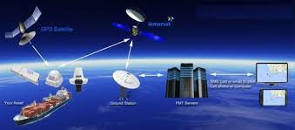
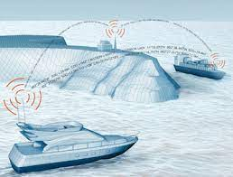
Working of AIS
AIS has one VHF transmitter, two VHF TDMA receivers, one VHF DSC receiver through which data are exchanged.

Slide 6
Data Transmitted By AIS
AIS transmits three types data. They are,
Static data
Dynamic data
Voyage data
Voyage data shows Navigation status, static draft, destination and ETA

Slide 7
Static Data
Static data is information that must be programmed into AIS at installation and is verified periodically.
Static data shows Name, length, breadth, MMSI, type, IMO No and antenna location.

Slide 8
Dynamic Data
Dynamic data is continuously broadcast every few seconds.
The dynamic data are acquired from internal or external sensors including GPS.
Dynamic data shows Position, course, speed, heading and rate of turn.

Slide 9
Voyage Data
Voyage data is manually entered and should always be kept updated.
Navigation status must be updated throughout the course of voyage.
Vessels broadcast every 2-10 seconds, whereas vessels that are anchored broadcast signals every 3 minutes.

Slide 10
Reasons For Inactivity of AIS
Low frequency region
Illegal fishing
Illegal drug smugling
Entering Country’s boundary without permission
Poor AIS device

Slide 11
Solution
We worked with two solutions. They are,
KNN Classification
Decision Tree Classifier

Slide 12
KNN Classification
KNN algorithm stands for K Nearest Neighbour
It is a supervised classification algorithm.
It is a non-parametric classification algorithm.
It uses proximity to make classification or prediction about grouping an individual data point.

Slide 13
Decision Tree Classifier
Decision Tree Classifier is a supervised classification algorithm.
It is a non-parametric classification algorithm.
It is used for both classification and regression task.
It has a hierarchical, tree structure, which consists of a root node, branches, internal nodes and leaf nodes.

Slide 14
Thank You

